Slide 1
MVC Putting all together
Pregatit de: Viorel TACLICIU Data: 20.07.2017

Slide 2
Topics - What to remember for mvc2 - What I learned - We need a story - To make an MVC framework
Pregatit de: Viorel TACLICIU Data: 20.07.2017

Slide 3
Schedule - What to remember - What I learned - Break - The story for(i->0..n-1){ - Making the MVC framework - Continue with a Break }
Pregatit de: Viorel TACLICIU Data: 20.07.2017

Slide 4
Break

Slide 5
What to remember for mvc2?

Slide 6






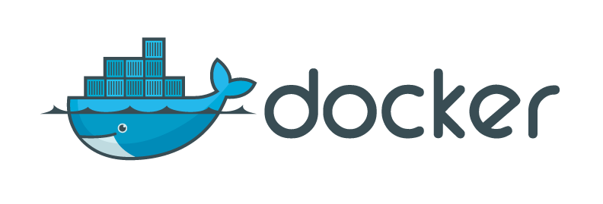



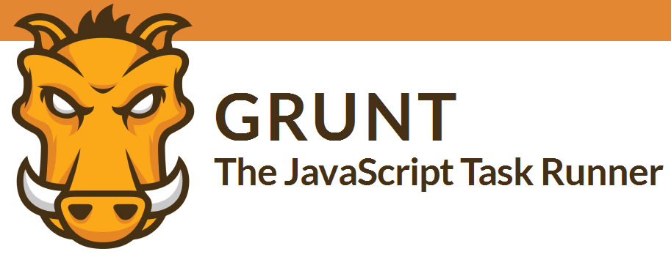




Remember
Application Server
Clients

Slide 7
Remember
Database
Java Applications
JDBC
API
SELECT/INSERT/UPDATE/DELETE
Driver
TCP Connections
Used to persist and search for data

Slide 8
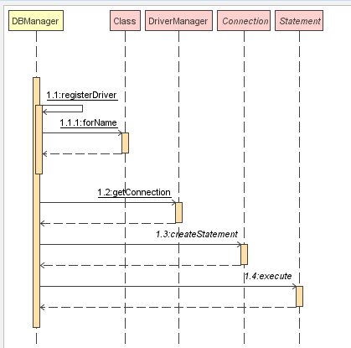
Remember
String DRIVER_CLASS = "oracle.jdbc.driver.OracleDriver";
public static Connection getConnection() throws ClassNotFoundException, SQLException { registerDriver(); Connection connection = DriverManager.getConnection(CONNECTION_STRING, DBProperties.USER, DBProperties.PASS); connection.createStatement().execute("alter session set current_schema="+DBProperties.SCHEMA); return connection; }
JDBC
API
TCP Connections
Driver

Slide 9
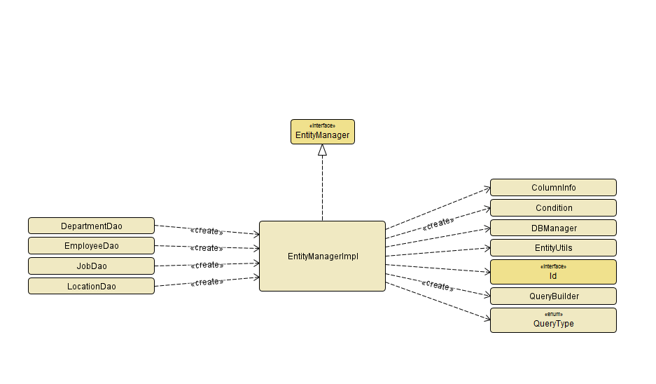
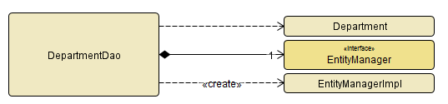
Remember
REPOSITORY

Slide 10
What I learned?

Slide 11
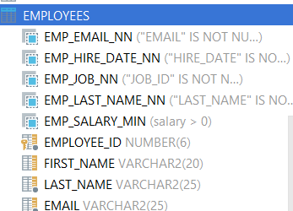
What I learned
LOGICAL DOMAIN
PHISICAL DOMAIN
@Table(name = "employees") public class Employee { @Id(name = "EMPLOYEE_ID") private Long id; @Column(name = "FIRST_NAME") private String firstName;

Slide 12
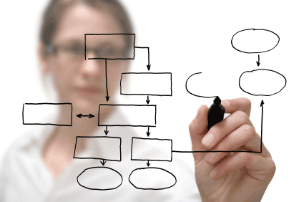
What I learned
TO DESIGN CLASSES I WILL USE:
IS-A – inheritance
HAS-A – composition
HAS-AN - aggregation
A House is a Building (inheritance)
A House has a Room (composition)
A House has an occupant (aggregation)

Slide 13
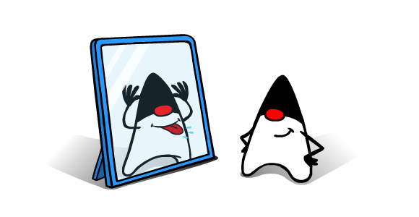
What I learned
Class.forName(“someClass”)
if (aClass.isAnnotationPresent(Z2HController.class)) { Z2HController controllerAnnotation = (Z2HController) aClass.getAnnotation(Z2HController.class);
if (method.isAnnotationPresent(Z2HRequestMethod.class)) { Z2HRequestMethod annotation = method.getAnnotation(Z2HRequestMethod.class);
Method[] controllerMethods = aClass.getMethods();
JAVA REFLECTION
Field[] fields = entity.getDeclaredFields();
entity.getClass().getSimpleName()
public static List<Field> getFieldsByAnnotations(Class clazz, Class annotation) {

Slide 14
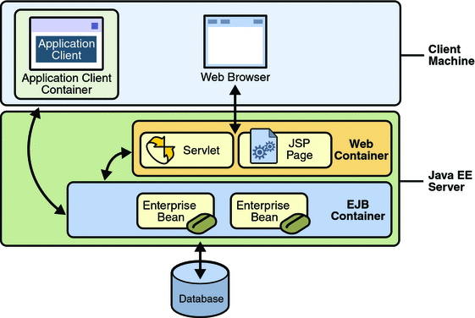
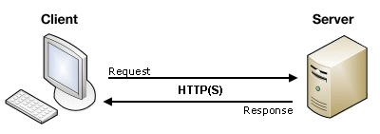
What I learned
Servlet containers
Servlet API

Slide 15
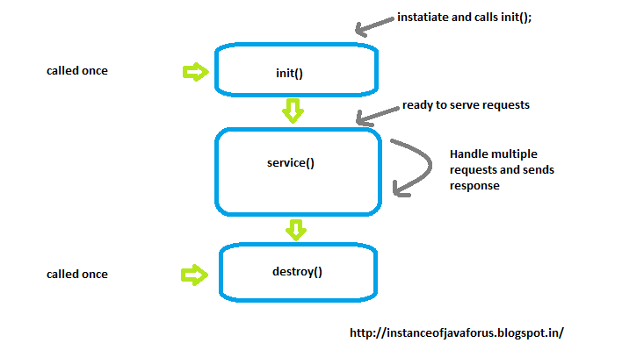
What I learned
The servlet context is maybe a better place to put shared information. See docs.oracle.com/javaee/6/api/javax/servlet

Slide 16
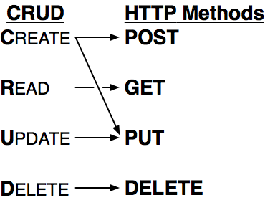
What I learned
public abstract class HttpServlet extends GenericServlet
protected void service(HttpServletRequest req, HttpServletResponse resp) throws ServletException, IOException
public class Z2HDispatcherServlet extends HttpServlet {
@Override protected void doGet(HttpServletRequest req, HttpServletResponse resp) throws ServletException, IOException { dispatchReply(req, resp, HttpMethod.GET); } @Override protected void doPost(HttpServletRequest req, HttpServletResponse resp) throws ServletException, IOException { dispatchReply(req, resp, HttpMethod.POST); } @Override protected void doDelete(HttpServletRequest req, HttpServletResponse resp) throws ServletException, IOException { dispatchReply(req, resp, HttpMethod.DELETE); } @Override protected void doPut(HttpServletRequest req, HttpServletResponse resp) throws ServletException, IOException { dispatchReply(req, resp, HttpMethod.PUT); }

Slide 17
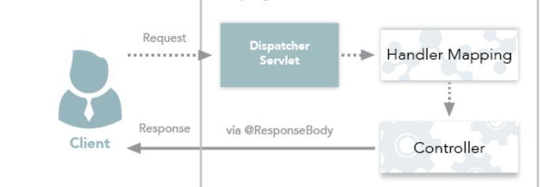
What I learned

Slide 18
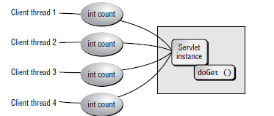
What I learned
A servlet instance is not thread safe?!!!
This means that your servlet must be stateless!!!

Slide 19
What I learned
public class Z2HDispatcherServlet extends HttpServlet {
public class ControllerScanner implements ComponentScanner {
public class BeanDeserializator {
public @interface Z2HController {
public @interface Z2HRequestMethod {
public @interface Z2HRequestObject {
public @interface Z2HRequestParam {

Slide 20

Break

Slide 21
The story

Slide 22
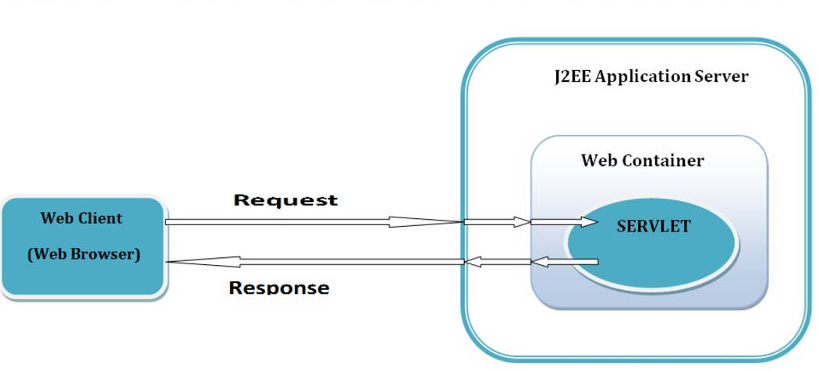
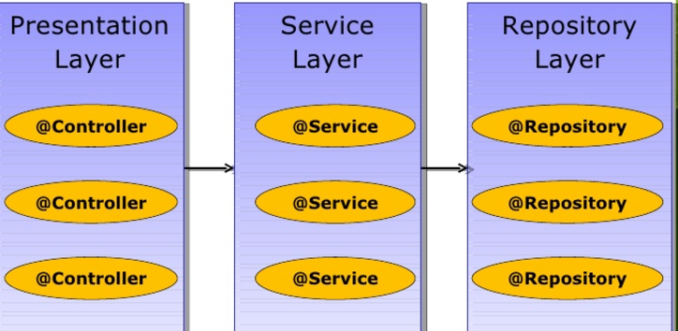


The story
HR Application
- take care of the employees
Architecture 3 tier:
- client (with angularJs)
Server side (with java 8 )
EIS – Enterprise Information System - database

Slide 23
The story
Service layer
- The business layer
- Start transactions
- Will be exposed as a rest endpoint through controller
Serialization from Java to Json and reverse- > use Jackson Library:
BeanDeserializator
Object requestBodyObject = new ObjectMapper().readValue(requestBodyReader, parameterType);
private void reply(HttpServletResponse resp, Object responseToDisplay) throws IOException {
ObjectMapper objectMapper = new ObjectMapper();
final String responseAsString = objectMapper.writeValueAsString(responseToDisplay);
resp.getWriter().print(responseAsString);
}

Slide 24
Questions?

Slide 25
MVC Framework

Slide 26
Z2HDispatcherServlet
MVC Framework
Fork https://github.com/ZeroToHero-2017/MVC.git
Switch to branch named “day2”
Write code to make the service layer
Write code into Z2HDispatcherServlet to complete the framework

Slide 27
Thank you!

